Slide 1
Data Mining Unit-I: Introduction to Data Mining
Dr.G.Padmavathi Associate professor CRRAO AIMSCS

Slide 2
Course Overview
Credits: 3 (L-T-P: 3-0-0)
Pre-requisites: Database Management Systems
Probability and Statistics
Goal: Introduce key data mining techniques & their applications

Slide 3
Data Mining Syllabus
UNIT - I
Introduction to Data Mining:
What Data mining? Kinds of Data, Knowledge Discovery process, Data Mining Functionalities, Kinds of Patterns, Major Issues in Data Mining. Data Objects and Attribute Types, Basic Statistical Descriptions of Data, Data Visualization, Measuring Data Similarity and Dissimilarity, Data Pre-processing: Major Tasks in Data Pre-processing, Data Cleaning, Data Integration, Data Reduction, Data Transformation and Data Discretization.
UNIT - II
Association Analysis: Basic Concepts, Market Basket Analysis, Apriori Algorithm, FP-growth, From Association Analysis to Correlation Analysis, Pattern Mining in Multilevel Associations and Multidimensional Associations.
UNIT - III
Classification: Basic Concepts, Decision Tree Induction, Bayes Classification Methods, Rule-Based Classification, Metrics for Evaluating Classifier Performance, Ensemble Methods, Multilayer Feed- Forward Neural Network, Support Vector Machines, k-Nearest-Neighbor Classifiers.
UNIT - IV
Cluster Analysis: Requirements for Cluster Analysis, Overview of Basic Clustering Methods, Partitioning Methods-k-Means, k-Medoids, Hierarchical Methods-AGENES, DIANA, BIRCH, Density- Based Method-DBSCAN, Outlier Analysis: Types of Outliers, Challenges of Outlier Detection, and Overview of Outlier Detection Methods
UNIT - V
Advanced Concepts: Web Mining- Web Content Mining, Web Structure Mining, Web Usage Mining, Spatial Mining- Spatial Data Overview, Spatial Data Mining Primitives, Spatial Rules, Spatial Classification Algorithm, Spatial Clustering Algorithms, Temporal Mining- Modeling Temporal Events, Time Series, Pattern Detection, Sequences, Temporal Association Rules.

Slide 4
TEXT BOOKS:
Jiawei Han, Micheline Kamber, Jian Pei., Data Mining: Concepts and Techniques, 3rd Edition, Morgan Kaufmann/Elsevier, 2012.
Margaret H Dunham, Data Mining Introductory and Advanced Topics, 2nd Edition, Pearson Education, India, 2006.
REFERENCE BOOKS:
Data Mining Techniques, Arun K Pujari, 3rd Edition, Universities Press.
Pang-Ning Tan, Michael Steinbach, Anuj Karpatne and Vipin Kumar, Introduction to Data Mining, 2nd Edition, Pearson Education India, 2021.
Amitesh Sinha, Data Warehousing, Thomson Learning, India, 2007.

Slide 5
UNIT - I Introduction to Data Mining
What Data mining?
Kinds of Data,
Knowledge Discovery process,
Data Mining Functionalities,
Kinds of Patterns,
Major Issues in Data Mining.
Data Pre-processing:
Major Tasks in Data Pre-processing,
Data Cleaning,
Data Integration,
Data Reduction,
Data Transformation and Data Discretization.
Data Objects and Attribute Types
Basic Statistical Descriptions of Data,
Data Visualization,
Measuring Data Similarity and Dissimilarity,

Slide 6
Unit I: Introductionto Data Mining
Data mining definitions, goals, and processes
Types of data, patterns, and issues
Data visualization, similarity measures
Data cleaning, integration, transformation

Slide 7
Chapter 2 in Prescribed textbook
Getting to Know Your Data
Data Objects and Attribute Types, Basic Statistical Descriptions of Data, Data Visualization, Measuring Data Similarity and Dissimilarity

Slide 8
Types of Data Sets
Record
Relational records
Data matrix, e.g., numerical matrix, crosstabs
Document data: text documents: term-frequency vector
Transaction data
Graph and network
World Wide Web
Social or information networks
Molecular Structures
Ordered
Video data: sequence of images
Temporal data: time-series
Sequential Data: transaction sequences
Genetic sequence data
Spatial, image and multimedia:
Spatial data: maps
Image data:
Video data:

Slide 9
Important Characteristics of Structured Data
Dimensionality
Curse of dimensionality
Sparsity
Only presence counts
Resolution
Patterns depend on the scale
Distribution
Centrality and dispersion

Slide 10
Data Objects
Data sets are made up of data objects.
A data object represents an entity.
Examples:
sales database: customers, store items, sales
medical database: patients, treatments
university database: students, professors, courses
Also called samples , examples, instances, data points, objects, tuples.
Data objects are described by attributes.
Database rows -> data objects; columns ->attributes.

Slide 11
Types of Attributes
Nominal Attributes
Binary Attributes
Ordinal Attributes
Numeric Attributes

Slide 12
Nominal Attributes
Categorical attributes with values that represent names or labels.
The values do not have any meaningful order.
Examples
Gender: male, female
Color: red, blue, green
Blood Group type: A, B, AB, O
City: Delhi, Mumbai, Chennai
Key Characteristics
No ordering or ranking among values
Can only check for equality or inequality
Values are discrete, not numeric
May be coded using numbers, but these numbers have no mathematical meaning
Operations Allowed
= (equal)
≠ (not equal)
Counting frequency of each category
Example Use Case
In a dataset of patients, the ‘Blood Group’ attribute is nominal.
We can count how many patients belong to each blood group, but we cannot rank or compare the blood groups.

Slide 13
Binary Attributes
A binary attribute has only two possible values:
Typically represented as 0/1, True/False, or Yes/No.
Types of Binary Attributes
Symmetric Binary
Both values are equally important
Example: Gender (male/female)
Asymmetric Binary
One value is more important (typically 1 = presence)
Example: Disease (1 = has disease, 0 = does not)
Representation
1 → presence of a property
0 → absence of a property
Applications
Medical diagnosis
User preferences (liked = 1, not liked = 0)
Fraud detection

Slide 14
Ordinal Attributes
Ordinal attributes have values that follow a meaningful order or rank, but the differences between them are not necessarily meaningful or equal.
Examples
Education level: primary < secondary < graduate < postgraduate
Satisfaction: unsatisfied < neutral < satisfied
Size: small < medium < large
Characteristics
Values have a natural ordering
Only rank information is meaningful
Cannot perform arithmetic operations like addition or averaging directly
Allowed Operations
Comparisons: =, ≠, <, >
Frequencies of each level
Median and mode can be used
Data can be transformed into numeric ranks for analysis
Use Cases
Surveys and feedback forms
Product ratings
Risk levels in assessments

Slide 15
Numerical Attributes
Numerical attributes are quantitative and represent measurable quantities. They allow arithmetic operations and have meaningful numeric values.
Types of Numerical Attributes
Interval
Ordered with meaningful differences
No true zero(zero doesn’t mean absence of quantity)
Example: temperature in Celsius or Fahrenheit
Ratio
Ordered with meaningful differences and a true zero
Example: height, weight, age, income
Characteristics
Values can be sorted and compared
Arithmetic operations are valid
Can calculate mean, median, mode, variance, and standard deviation
Outliers and patterns can be analysed
Allowed Operations
Comparisons: =, ≠, <, >
Arithmetic: +, −, ×, ÷
Statistical analysis: correlation, regression
Use Cases
Financial data analysis
Scientific measurements
Sensor readings
Student scores

Slide 16
Discrete vs. Continuous Attributes
Discrete Attribute
Take finite or countably infinite values
Often integers or categories
Example values: 0, 1, 2, 3...
Can be nominal, ordinal, or numeric
Examples
Number of children
Grade levels
Product categories
zip codes,
the set of words in a collection of documents
Continuous Attribute
Take infinite, uncountable values within a range
Represent measurable quantities
Often come from physical measurements
Examples
Height: 165.2 cm
Temperature: 37.6 °C
Time: 3.15 seconds

Slide 17
Basic Statistical Descriptions of Data

Slide 18
Basic Statistical Descriptions of Data
To summarize and understand the main features of a dataset using key statistics.
Measures of Central Tendency
Mean: Average of all values
Median: Middle value when sorted
Mode: Most frequent value
Measures of Dispersion (Spread)
Range: Max − Min
Variance: Average squared deviation from mean
Standard Deviation (SD): Square root of variance

Slide 19
Basic Statistical Descriptions of Data
Motivation
To better understand the data: central tendency, variation and spread
Data dispersion characteristics
median, max, min, quantiles, outliers, variance, etc.
Numerical dimensions correspond to sorted intervals
Data dispersion: analyzed with multiple granularities of precision
Boxplot or quantile analysis on sorted intervals
Dispersion analysis on computed measures
Folding measures into numerical dimensions
Boxplot or quantile analysis on the transformed cube

Slide 20
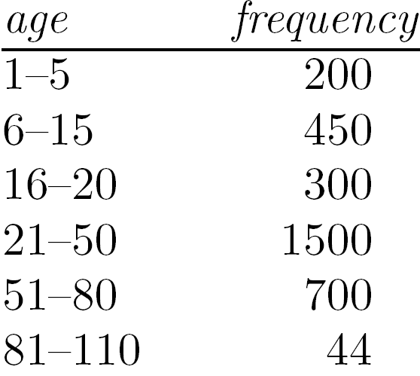
Measuring the Central Tendency
Mean (algebraic measure) (sample vs. population):
Note: n is sample size and N is population size.
Weighted arithmetic mean:
Trimmed mean: chopping extreme values
Median:
Middle value if odd number of values, or average of the middle two values otherwise
Estimated by interpolation (for grouped data):
Mode
Value that occurs most frequently in the data
Unimodal, bimodal, trimodal
Empirical formula:

Slide 21
Symmetric vs. Skewed Data
Shape of Data Distribution:
Skewness
Measures asymmetry
Positive skew: tail on right
Negative skew: tail on left
Median, mean and mode of symmetric, positively and negatively skewed data

Slide 22
Kurtosis
Measures "peakedness"
High kurtosis: sharp peak
Low kurtosis: flat shape

Slide 23
Measuring the Dispersion of Data
Quartiles, outliers and boxplots
Quartiles: Q₁ (25th percentile), Q₃ (75th percentile)
Inter-quartile range: IQR = Q₃ – Q₁
Five number summary: min, Q₁, median, Q₃, max
Boxplot: ends of the box are the quartiles; median is marked; add whiskers, and plot outliers individually
Outlier: usually, a value higher/lower than 1.5 x IQR
Variance and standard deviation (sample: s, population: σ)
Variance: (algebraic, scalable computation)
Standard deviation s (or σ) is the square root of variance s² ⁽or σ²⁾

Slide 24
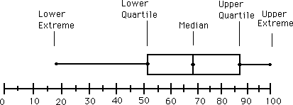
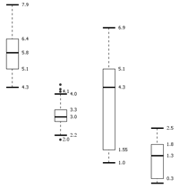
Boxplot Analysis
Five-number summary of a distribution
Minimum, Q1, Median, Q3, Maximum
Boxplot
Data is represented with a box
The ends of the box are at the first and third quartiles, i.e., the height of the box is IQR (Interquartile Range)
The median is marked by a line within the box
Whiskers: two lines outside the box extended to Minimum and Maximum
Outliers: points beyond a specified outlier threshold, plotted individually

Slide 25
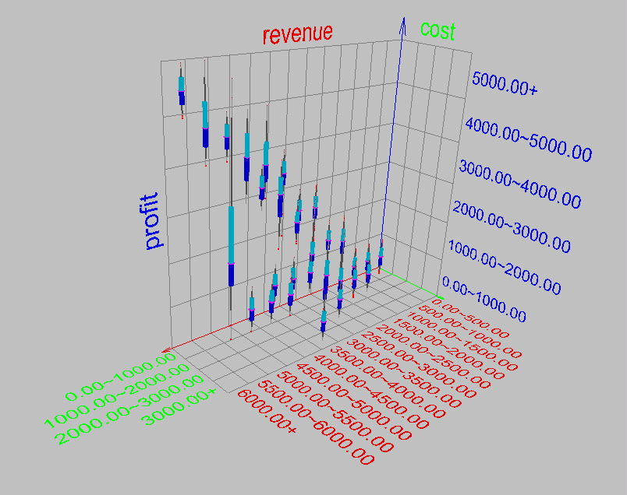
Visualization of Data Dispersion: 3-D Boxplots

Slide 26
Properties of Normal Distribution Curve
The normal (distribution) curve
From μ–σ to μ+σ: contains about 68% of the measurements (μ: mean, σ: standard deviation)
From μ–2σ to μ+2σ: contains about 95% of it
From μ–3σ to μ+3σ: contains about 99.7% of it

Slide 27
Graphic Displays of Basic Statistical Descriptions
Boxplot: graphic display of five-number summary
Histogram: x-axis are values, y-axis repres. frequencies
Quantile plot: each value x_{i} is paired with f_{i} indicating that approximately 100 f_{i} % of data are ≤ x_{i}
Quantile-quantile (q-q) plot: graphs the quantiles of one univariant distribution against the corresponding quantiles of another
Scatter plot: each pair of values is a pair of coordinates and plotted as points in the plane

Slide 28
Histogram Analysis
Histogram: Graph display of tabulated frequencies, shown as bars
It shows what proportion of cases fall into each of several categories
Differs from a bar chart in that it is the area of the bar that denotes the value, not the height as in bar charts, a crucial distinction when the categories are not of uniform width
The categories are usually specified as non-overlapping intervals of some variable. The categories (bars) must be adjacent

Slide 29
Histograms Often Tell More than Boxplots
The two histograms shown in the left may have the same boxplot representation
The same values for: min, Q1, median, Q3, max
But they have rather different data distributions

Slide 30
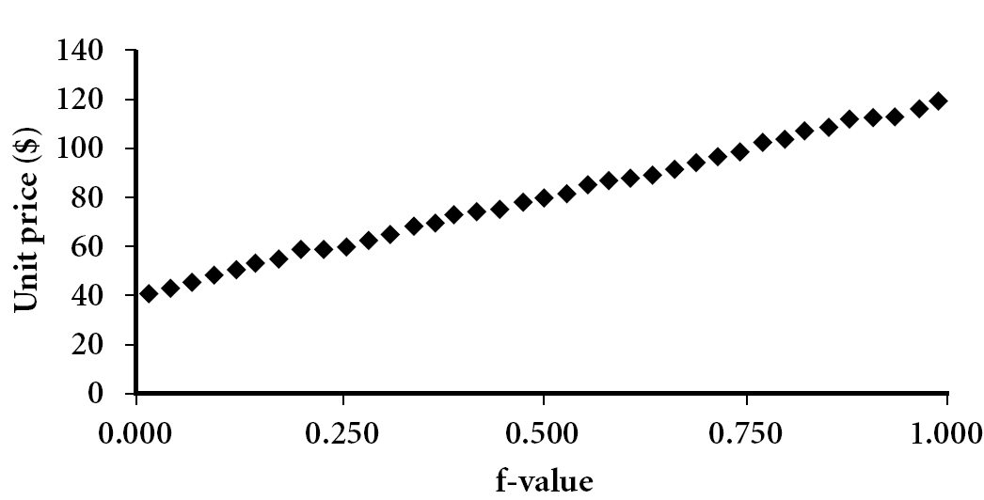
Quantile Plot
Displays all of the data (allowing the user to assess both the overall behavior and unusual occurrences)
Plots quantile information
For a data x_{i} data sorted in increasing order, f_{i} indicates that approximately 100 f_{i}% of the data are below or equal to the value x_{i}

Slide 31
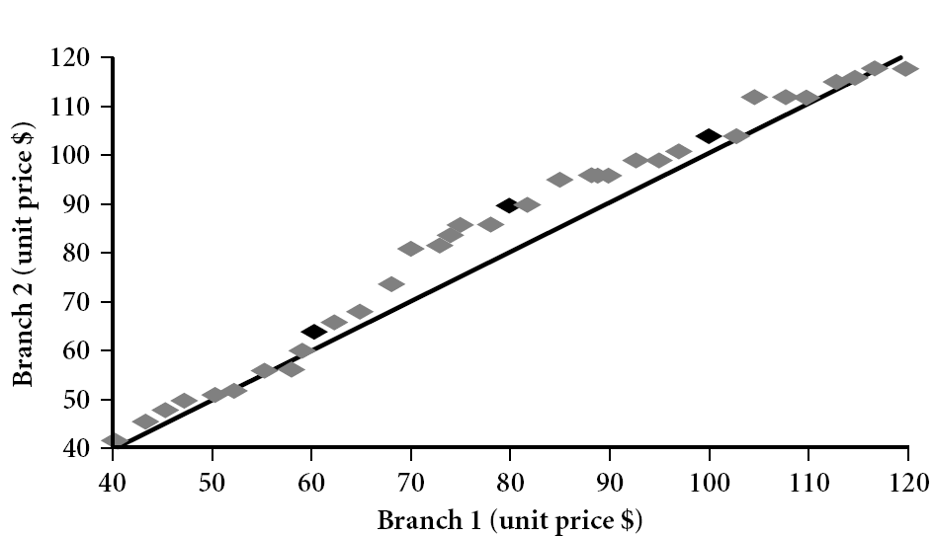
Quantile-Quantile (Q-Q) Plot
Graphs the quantiles of one univariate distribution against the corresponding quantiles of another
View: Is there is a shift in going from one distribution to another?
Example shows unit price of items sold at Branch 1 vs. Branch 2 for each quantile. Unit prices of items sold at Branch 1 tend to be lower than those at Branch 2.
Note: We need to label the dark plotted points as Q1, Median, Q3 – that would help in understanding this graph.
Tell audience: There is a shift in distribution of branch 1 WRT branch 2 in that the unit prices of items sold at branch 1 tend to be lower than those at branch 2.
Notes:
Note: We need to label the dark plotted points as Q1, Median, Q3 – that would help in understanding this graph.
Tell audience: There is a shift in distribution of branch 1 WRT branch 2 in that the unit prices of items sold at branch 1 tend to be lower than those at branch 2.

Slide 32
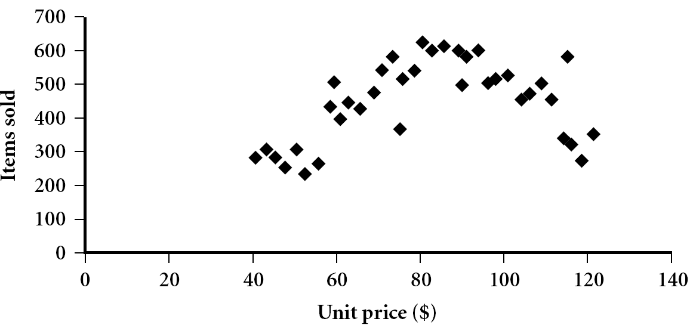
Scatter plot
Provides a first look at bivariate data to see clusters of points, outliers, etc
Each pair of values is treated as a pair of coordinates and plotted as points in the plane

Slide 33
Positively and Negatively Correlated Data
The left half fragment is positively correlated
The right half is negative correlated

Slide 34
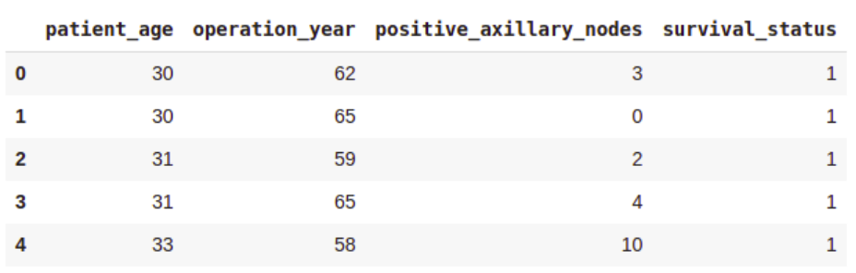
Dataset Description
The dataset can be provided by the Industry or downloaded form open source.
Haberman's Survival Data:
https://www.kaggle.com/datasets/gilsousa/habermans-survival-data-set.
Attribute Information
Patient’s age at the time of operation (numerical).
Year of operation (year — 1900, numerical).
A number of positive axillary nodes were detected (numerical).
Survival status (class attribute)
The patient survived 5 years or longer post-operation.
The patient died within 5 years post-operation.
Attributes 1, 2, and 3 form our features (independent variables), while attribute 4 is our class label (dependent variable).

Slide 35
Importing Libraries and Loading Data
Importing Libraries
import numpy as np
import pandas as pd
import matplotlib.pyplot as plt
import seaborn as sns
import scipy.stats as stats
Load the dataset in pandas dataframe:
df = pd.read_csv('haberman.csv', header = 0)
df.columns = ['patient_age', 'operation_year', 'positive_axillary_nodes', 'survival_status']

Slide 36
Understanding Data
To understand the dataset, let’s just see the first few rows.
print(df.head())
To understand the size of the dataset, we check its shape.
df.shape
Output (305, 4)
To Check for Missing Values
print("Missing values in each column:\n", df.isnull().sum())
For Data Information: Let’s get a summary of the dataset to understand the data types and further verify the absence of missing values.
df.info()

Slide 37
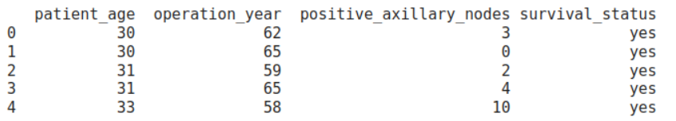
Understanding Data- Data Preparation
Data Preparation:
Before proceeding with statistical analysis and visualization, we need to modify the original class labels. The current labels are 1 (survived 5 years or more) and 2 (died within 5 years), which are not very descriptive. We’ll map these to more intuitive categorical variables: ‘yes’ for survival and ‘no’ for non-survival.
# Map survival status values to categorical variables 'yes' and 'no'
df['survival_status'] = df['survival_status'].map({1: 'yes', 2: 'no'})
# Display the updated DataFrame to verify changes
print(df.head())

Slide 38
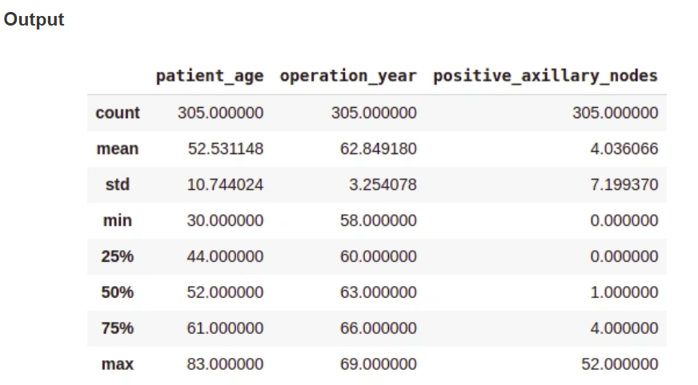
Understanding Data- General Statistical Analysis
General Statistical Analysis:
We will now perform a general statistical analysis to understand the overall distribution and central tendencies of the data.
# Display summary statistics of the DataFrame
df .describe ()
On average, patients got operated at age of 52.
The average number of positive axillary nodes detected = 4.
As indicated by the 50th percentile, the median of positive axillary nodes is 1.
As indicated by the 75th percentile, 75% of the patients have less than 4 nodes detected.
If you see, there is a significant difference between the mean and the median values. This is because there are some outliers in our data and the mean is influenced by the presence of outliers.

Slide 39
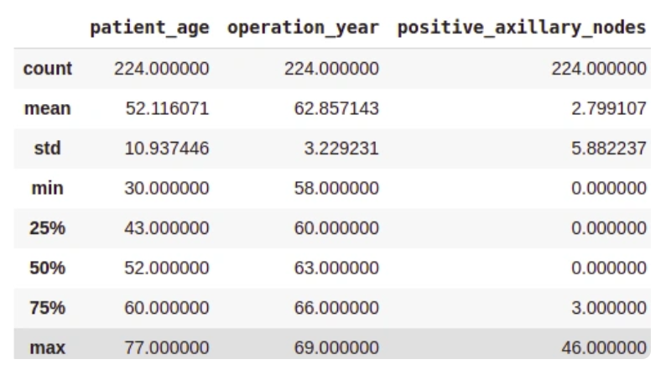
Understanding Data- Class-wise Statistical Analysis
Class-wise Statistical Analysis: To gain deeper insights, we’ll perform a statistical analysis for each class (survived vs. not survived) separately.
Survived (Yes) Analysis:
survival_yes = df[df['survival_status'] == 'yes']
print(survival_yes.describe())

Slide 40
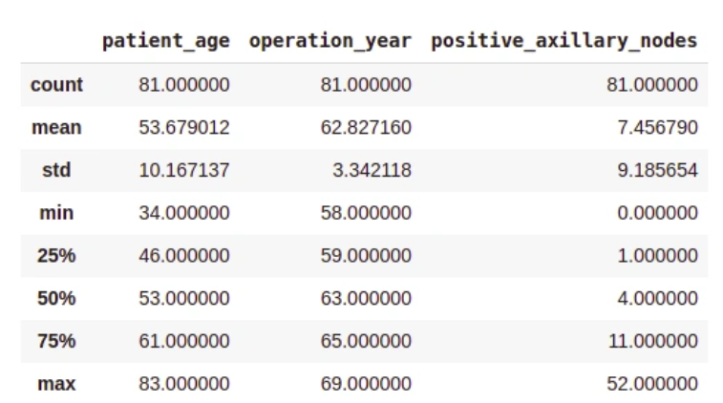
Understanding Data- Class-wise Statistical Analysis Contd…
Class-wise Statistical Analysis: To gain deeper insights, we’ll perform a statistical analysis for each class (survived vs. not survived) separately.
Not Survived (No) Analysis:
survival_no = df[df['survival_status'] == 'no']
print(survival_no.describe())

Slide 41
Understanding Data- Class-wise Statistical Analysis Contd…
From the above class-wise analysis, it can be observed that —
The average age at which the patient is operated on is nearly the same in both cases.
Patients who died within 5 years on average had about 4 to 5 positive axillary nodes more than the patients who lived over 5 years post-operation.

Slide 42
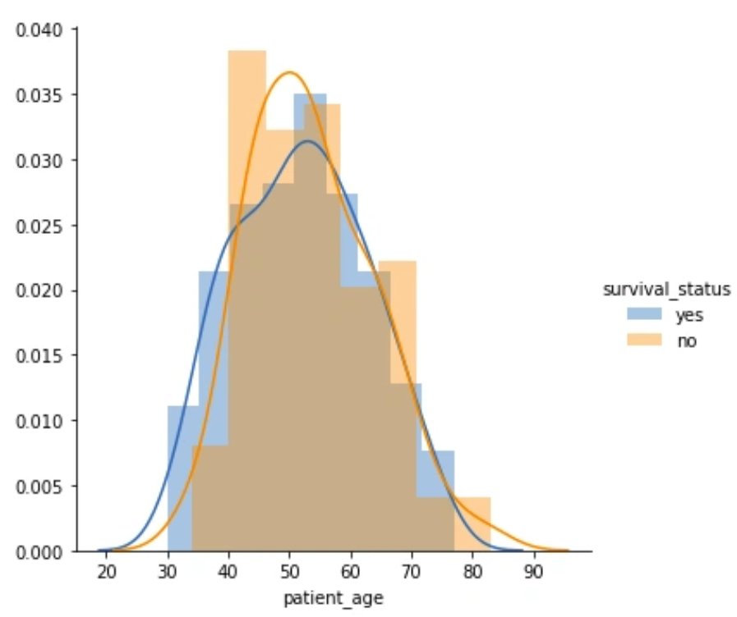
Uni-variate Data Analysis
Uni-variate analysis involves studying one variable at a time. This type of analysis helps in understanding the distribution and characteristics of each variable individually. Below are different ways to perform uni-variate analysis along with their outputs and interpretations.
Distribution Plots:
Distribution plots, also known as probability density function (PDF) plots, show how values in a dataset are spread out. They help us see the shape of the data distribution and identify patterns.
sns.FacetGrid(data, hue="Survival_Status", height=5).map(sns.histplot, "Age", kde=True).add_legend()
plt.title('Distribution of Age')
plt.xlabel('Age')
plt.ylabel('Frequency')
plt.show()
Among all age groups, patients aged 40-60 years are the highest.
There is a high overlap between the class labels, implying that survival status post-operation cannot be discerned from age alone.

Slide 43
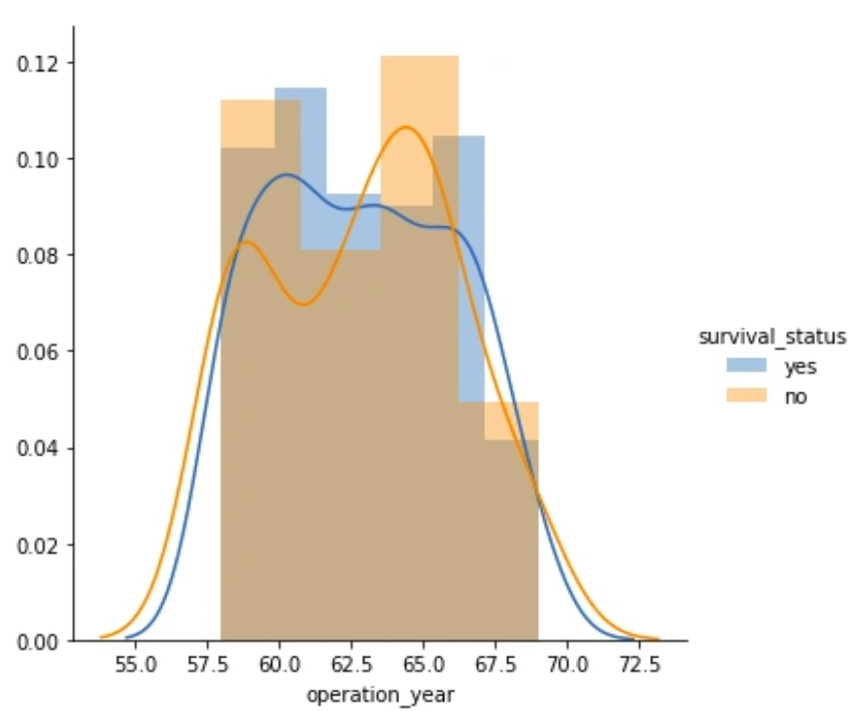
Uni-variate Data Analysis- Distribution Plots Contd..
Operation Year
sns.FacetGrid(data, hue="Survival_Status", height=5).map(sns.histplot, "Year", kde=True).add_legend()
plt.title('Distribution of Operation Year')
plt.xlabel('Operation Year')
plt.ylabel('Frequency')
plt.show()
Similar to the age plot, there is a significant overlap between the class labels, suggesting that operation year alone is not a distinctive factor for survival status.

Slide 44
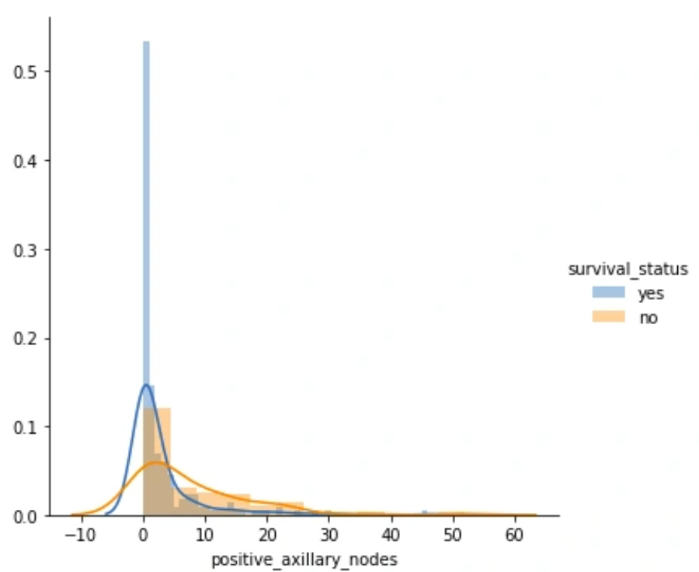
Uni-variate Data Analysis- Distribution Plots Contd..
Number of Positive Axillary Nodes
sns.FacetGrid(data, hue="Survival_Status", height=5).map(sns.histplot, "Nodes", kde=True).add_legend()
plt.title('Distribution of Positive Axillary Nodes')
plt.xlabel('Number of Positive Axillary Nodes')
plt.ylabel('Frequency')
plt.show()
Patients with 4 or fewer axillary nodes mostly survived 5 years or longer.
Patients with more than 4 axillary nodes have a lower likelihood of survival compared to those with 4 or fewer nodes.

Slide 45
Uni-variate Data Analysis- Distribution Plots Contd..
Cumulative Distribution Function (CDF): CDF plots show the probability that a variable will take a value less than or equal to a specific value. They provide a cumulative measure of the distribution.
counts, bin_edges = np.histogram(data[data['Survival_Status'] == 1]['Nodes'], density=True)
pdf = counts / sum(counts)
cdf = np.cumsum(pdf)
plt.plot(bin_edges[1:], cdf, label='CDF Survival status = Yes')
counts, bin_edges = np.histogram(data[data['Survival_Status'] == 2]['Nodes'], density=True)
pdf = counts / sum(counts)
cdf = np.cumsum(pdf)
plt.plot(bin_edges[1:], cdf, label='CDF Survival status = No')
plt.legend()
plt.xlabel("Positive Axillary Nodes")
plt.ylabel("CDF")
plt.title('Cumulative Distribution Function for Positive Axillary Nodes')
plt.grid()
plt.show()

Slide 46
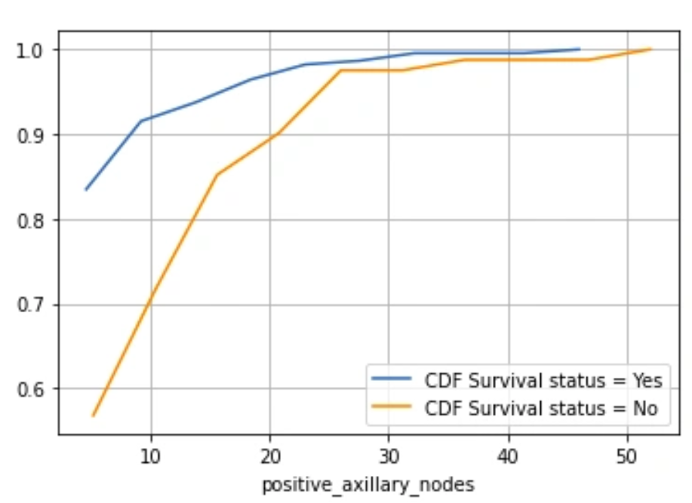
Uni-variate Data Analysis- Distribution Plots Contd..
Cumulative Distribution Function (CDF): CDF plots show the probability that a variable will take a value less than or equal to a specific value. They provide a cumulative measure of the distribution.
counts, bin_edges = np.histogram(data[data['Survival_Status'] == 1]['Nodes'], density=True)
pdf = counts / sum(counts)
cdf = np.cumsum(pdf)
plt.plot(bin_edges[1:], cdf, label='CDF Survival status = Yes')
counts, bin_edges = np.histogram(data[data['Survival_Status'] == 2]['Nodes'], density=True)
pdf = counts / sum(counts)
cdf = np.cumsum(pdf)
plt.plot(bin_edges[1:], cdf, label='CDF Survival status = No')
plt.legend()
plt.xlabel("Positive Axillary Nodes")
plt.ylabel("CDF")
plt.title('Cumulative Distribution Function for Positive Axillary Nodes')
plt.grid()
plt.show()
Patients with 4 or fewer positive axillary nodes have about an 85% chance of surviving 5 years or longer post-operation.
The likelihood decreases for patients with more than 4 axillary nodes.

Slide 47
Uni-variate Data Analysis- Box Plots Contd..
Box plots, also known as box-and-whisker plots, summarize data using five key metrics: minimum, lower quartile (25th percentile), median (50th percentile), upper quartile (75th percentile), and maximum. They also highlight outliers.
plt.figure(figsize=(15, 4))
plt.subplot(1, 3, 1)
sns.boxplot(x='Survival_Status', y='Age', data=data)
plt.title('Box Plot of Age')
plt.subplot(1, 3, 2)
sns.boxplot(x='Survival_Status', y='Year', data=data)
plt.title('Box Plot of Operation Year')
plt.subplot(1, 3, 3)
sns.boxplot(x='Survival_Status', y='Nodes', data=data)
plt.title('Box Plot of Positive Axillary Nodes')
plt.show()

Slide 48
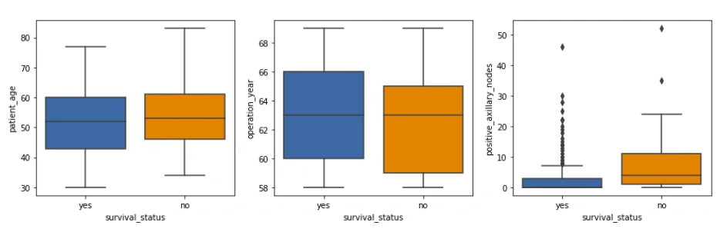
Uni-variate Data Analysis- Box Plots Contd..
The patient age and operation year plots show similar statistics.
The isolated points in the positive axillary nodes box plot are outliers, which is expected in medical datasets.

Slide 49
Uni-variate Data Analysis- Violin Plots
Violin plots combine the features of box plots and density plots. They provide a visual summary of the data and show the distribution’s shape, density, and variability.
plt.figure(figsize=(15, 4))
plt.subplot(1, 3, 1)
sns.violinplot(x='Survival_Status', y='Age', data=data)
plt.title('Violin Plot of Age')
plt.subplot(1, 3, 2)
sns.violinplot(x='Survival_Status', y='Year', data=data)
plt.title('Violin Plot of Operation Year')
plt.subplot(1, 3, 3)
sns.violinplot(x='Survival_Status', y='Nodes', data=data)
plt.title('Violin Plot of Positive Axillary Nodes')
plt.show()

Slide 50
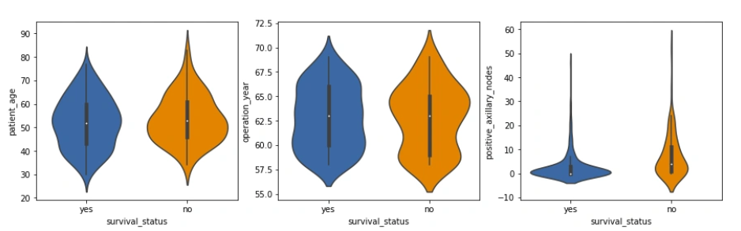
Uni-variate Data Analysis- Violin Plots
The distribution of positive axillary nodes is highly skewed for the ‘yes’ class label and moderately skewed for the ‘no’ label.
The majority of patients, regardless of survival status, have a lower number of positive axillary nodes, with those having 4 or fewer nodes more likely to survive 5 years post-operation.
These observations align with our previous analyses and provide a deeper understanding of the data.

Slide 51
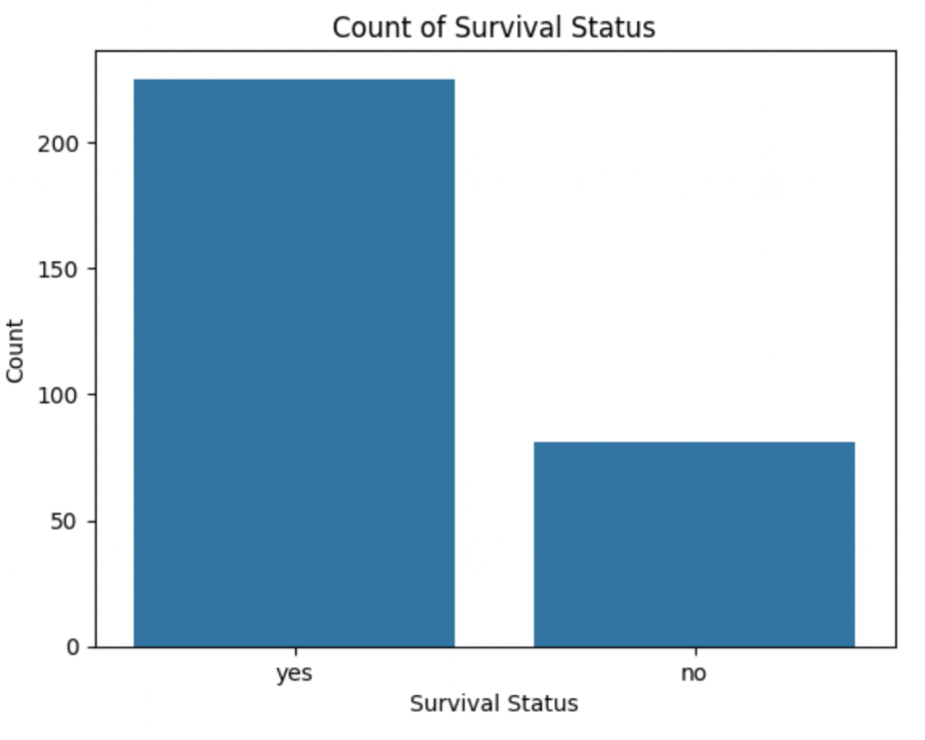
Uni-variate Data Analysis- Bar Charts
Bar charts display the frequency or count of categories within a single variable, making them useful for comparing different groups.
Survival Status Count
sns.countplot(x='Survival_Status', data=df)
plt.title('Count of Survival Status')
plt.xlabel('Survival Status')
plt.ylabel('Count')
plt.show()
This bar chart shows the number of patients who survived 5 years or longer versus those who did not. It helps visualize the class imbalance in the dataset.

Slide 52
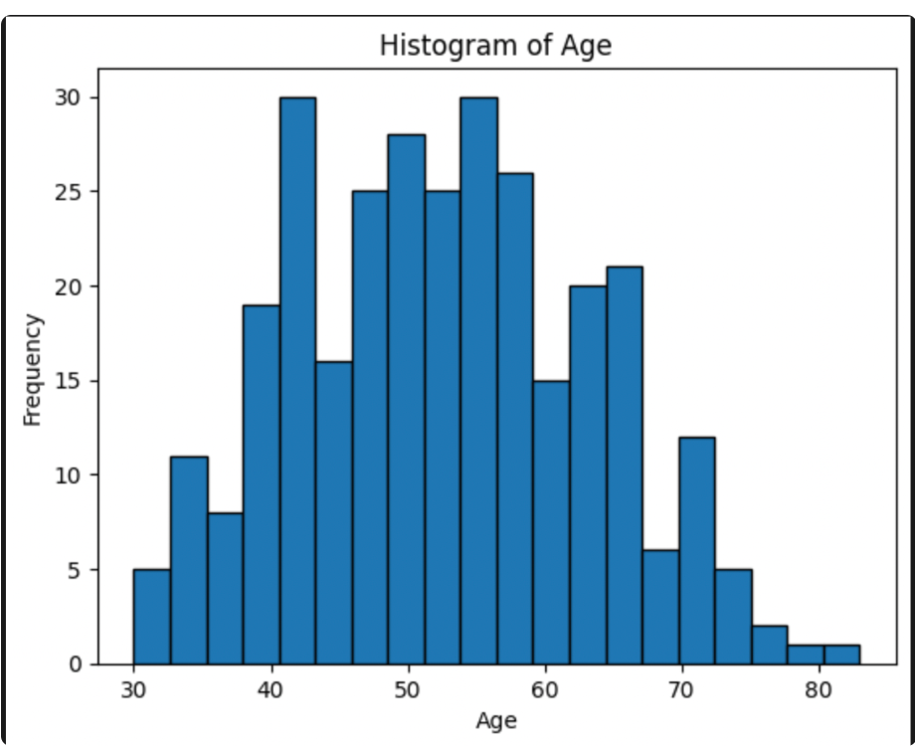
Uni-variate Data Analysis- Histograms
Histograms show the distribution of numerical data by grouping data points into bins. They help understand the frequency distribution of a variable.
Age Distribution
df['Age'].plot(kind='hist', bins=20, edgecolor='black')
plt.title('Histogram of Age')
plt.xlabel('Age')
plt.ylabel('Frequency')
plt.show()
The histogram displays how the ages of patients are distributed. Most patients are between 40 and 60 years old.

Slide 53
Bi-variate Data Analysis-Pair Plot
Bi-variate data analysis involves studying the relationship between two variables at a time. This helps in understanding how one variable affects another and can reveal underlying patterns or correlations. Here are some common methods for bi-variate analysis.
Pair Plot
A pair plot visualizes the pairwise relationships between variables in a dataset. It displays both the distributions of individual variables and their relationships.
sns.set_style('whitegrid')
sns.pairplot(data, hue='Survival_Status')
plt.show()

Slide 54
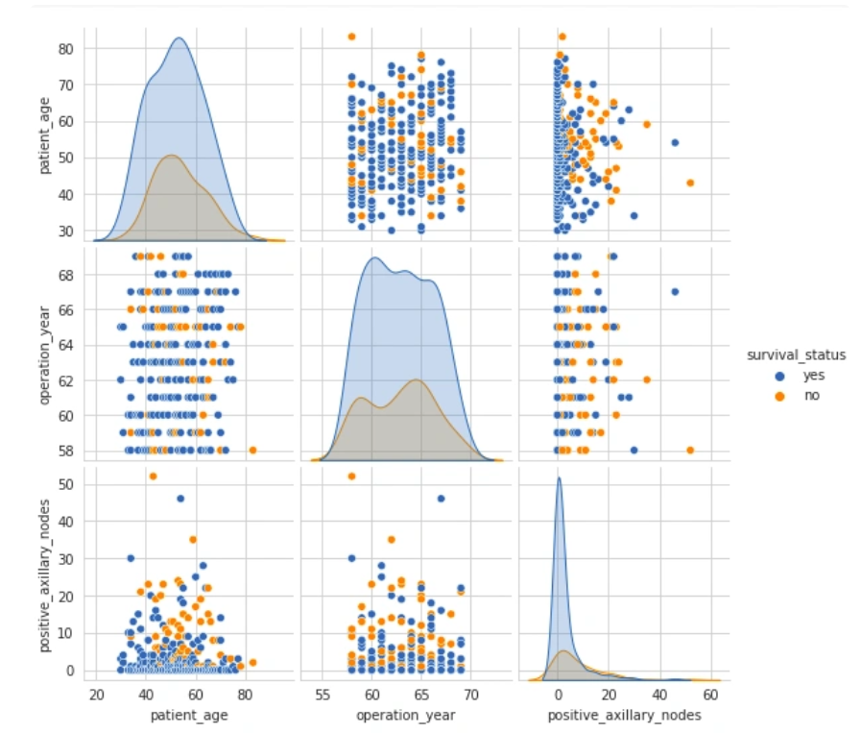
Bi-variate Data Analysis-Pair Plot
The pair plot shows scatter plots of each pair of variables and histograms of each variable along the diagonal.
The scatter plots on the upper and lower halves of the matrix are mirror images, so analyzing one half is sufficient.
The histograms on the diagonal show the univariate distribution of each feature.
There is a high overlap between any two features, indicating no clear distinction between the survival status class labels based on feature pairs.
While the pair plot provides an overview of the relationships between all pairs of variables, sometimes it is useful to focus on the relationship between just two specific variables in more detail. This is where the joint plot comes in.

Slide 55
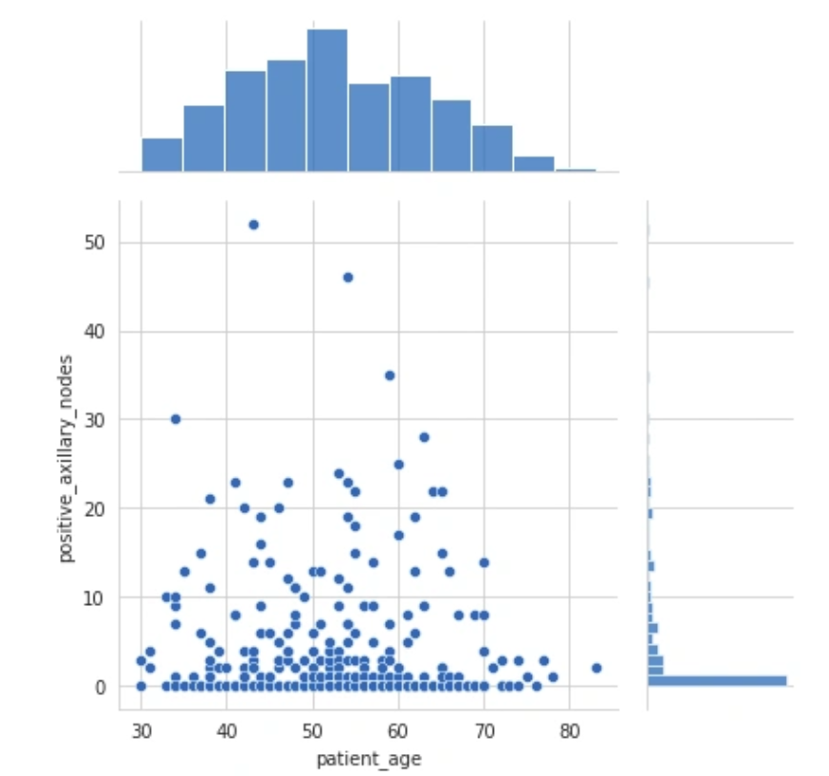
Bi-variate Data Analysis-Joint Plot
A joint plot provides a detailed view of the relationship between two variables along with their individual distributions.
sns.jointplot(x='Age', y='Nodes', data=data, kind='scatter')
plt.show()

Slide 56
Bi-variate Data Analysis-Joint Plot
The scatter plot in the center shows no correlation between the patient’s age and the number of positive axillary nodes detected.
The histogram on the top edge shows that patients are more likely to get operated on between the ages of 40 and 60 years.
The histogram on the right edge indicates that the majority of patients had fewer than 4 positive axillary nodes.
While joint plots and pair plots help visualize the relationships between pairs of variables, a heatmap can provide a broader view of the correlations among all the variables in the dataset simultaneously.

Slide 57
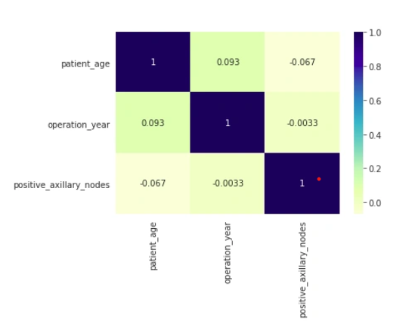
Bi-variate Data Analysis-Heatmap
Heatmap
A heatmap visualizes the correlation between different variables. It uses color coding to represent the strength of the correlations, which can help identify relationships between variables.
sns.heatmap(data.corr(), cmap='YlGnBu', annot=True)
plt.show()

Slide 58
Bi-variate Data Analysis-Heatmap
The heatmap displays Pearson’s R values, indicating the correlation between pairs of variables.
Correlation values close to 0 suggest no linear relationship between the variables.
In this dataset, there are no strong correlations between any pairs of variables, as most values are near 0.
These bi-variate analysis techniques provide valuable insights into the relationships between different features in the dataset, helping to understand how they interact and influence each other. Understanding these relationships is crucial for building more accurate models and making informed decisions in data analysis and machine learning tasks

Slide 59
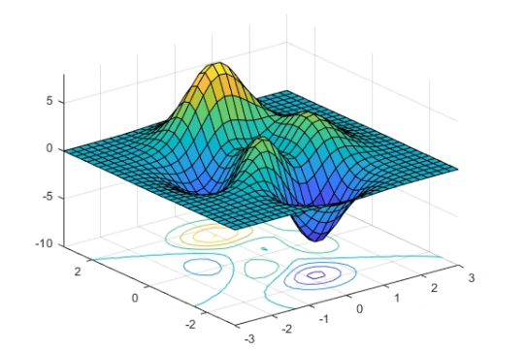
Multivariate Analysis-Contour Plot
Multivariate analysis involves examining more than two variables simultaneously to understand their relationships and combined effects. This type of analysis is essential for uncovering complex interactions in data. Let’s explore several multivariate analysis techniques.
Contour Plot:
A contour plot is a graphical technique that represents a 3-dimensional surface by plotting constant z slices, called contours, in a 2-dimensional format. This allows us to visualize complex relationships between three variables in an easily interpretable 2-D chart.

Slide 60
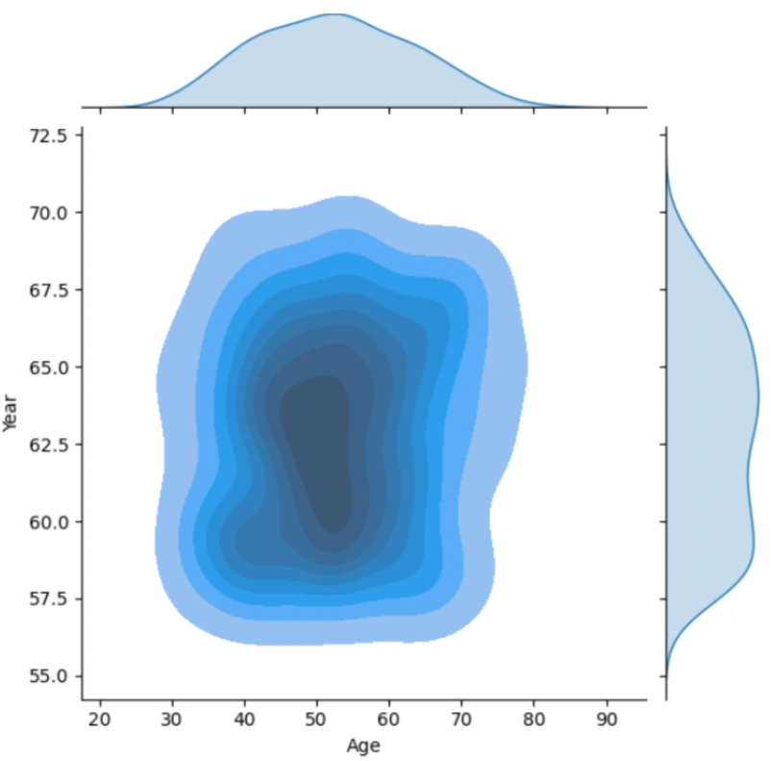
Multivariate Analysis-Contour Plot
Now we examine the relationship between patient’s age and operation year, and how these relate to the number of patients.
sns.jointplot(x='Age', y='Year', data=data, kind='kde', fill=True)
plt.show()
From the above contour plot, it can be observed that the years 1959–1964 witnessed more patients in the age group of 45–55 years.
The contour lines represent the density of data points. Closer contour lines indicate a higher density of data points.
The areas with the darkest shading represent the highest density of patients, showing the most common combinations of age and operation year.
By utilizing contour plots, we can effectively consolidate information from three dimensions into a two-dimensional format, making it easier to identify patterns and relationships in the data. This approach enhances our ability to perform comprehensive multivariate analysis and extract valuable insights from complex datasets.

Slide 61
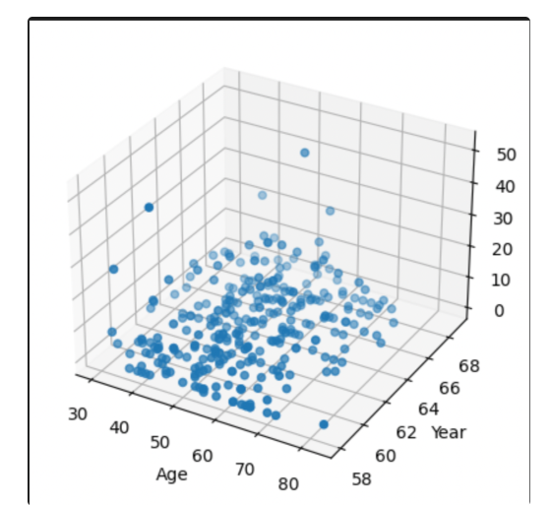
Multivariate Analysis- 3D Scatter Plot
3D Scatter Plot:
A 3D scatter plot is an extension of the traditional scatter plot into three dimensions, which allows us to visualize the relationship among three variables.
from mpl_toolkits.mplot3d import Axes3D
fig = plt.figure()
ax = fig.add_subplot(111, projection='3d')
ax.scatter(df['Age'], df['Year'], df['Nodes'])
ax.set_xlabel('Age')
ax.set_ylabel('Year')
ax.set_zlabel('Nodes')
plt.show()

Slide 62
Data Visualization

Slide 63
Data Visualization
Why data visualization?
Gain insight into an information space by mapping data onto graphical primitives
Provide qualitative overview of large data sets
Search for patterns, trends, structure, irregularities, relationships among data
Help find interesting regions and suitable parameters for further quantitative analysis
Provide a visual proof of computer representations derived
Categorization of visualization methods:
Pixel-oriented visualization techniques
Geometric projection visualization techniques
Icon-based visualization techniques
Hierarchical visualization techniques
Visualizing complex data and relations

Slide 64
Pixel-Oriented Visualization Techniques
For a data set of m dimensions, create m windows on the screen, one for each dimension
The m dimension values of a record are mapped to m pixels at the corresponding positions in the windows
The colors of the pixels reflect the corresponding values
Income
(b) Credit Limit
(c) transaction volume
(d) age
64
Notes:
64

Slide 65
Laying Out Pixels in Circle Segments
To save space and show the connections among multiple dimensions, space filling is often done in a circle segment
Representing a data record in circle segment
(b) Laying out pixels in circle segment
65
Notes:
65

Slide 66
Geometric Projection Visualization Techniques
Visualization of geometric transformations and projections of the data
Methods
Direct visualization
Scatterplot and scatterplot matrices
Landscapes
Projection pursuit technique: Help users find meaningful projections of multidimensional data
Prosection views
Hyperslice
Parallel coordinates

Slide 67
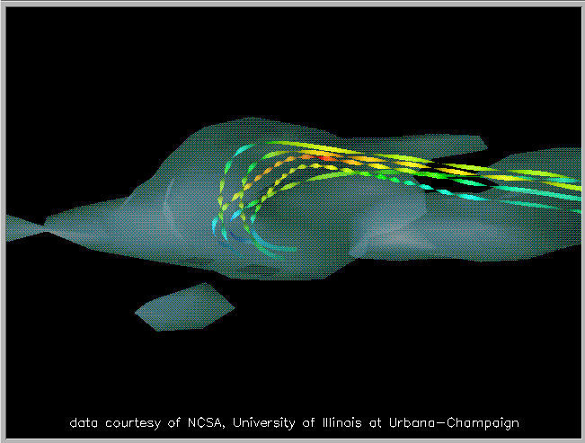
Direct Data Visualization
Ribbons with Twists Based on Vorticity
Notes:
http://books.elsevier.com/companions/1558606890/pictures/Chapter_01/fig1-6b.gif

Slide 68
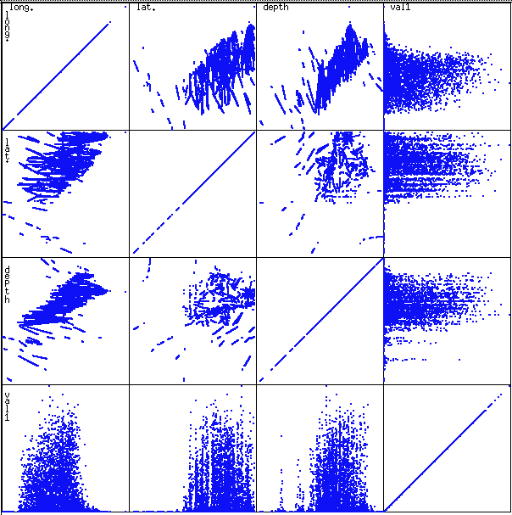
Scatterplot Matrices
Used by ermission of M. Ward, Worcester Polytechnic Institute
Matrix of scatterplots (x-y-diagrams) of the k-dim. data [total of (k2/2-k) scatterplots]

Slide 69
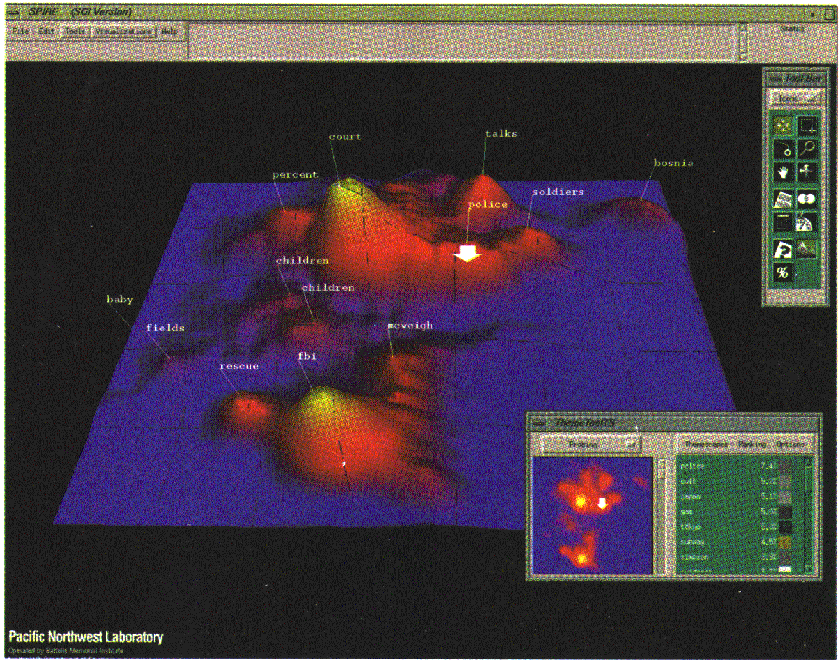
Landscapes
news articles visualized as a landscape
Used by permission of B. Wright, Visible Decisions Inc.
Visualization of the data as perspective landscape
The data needs to be transformed into a (possibly artificial) 2D spatial representation which preserves the characteristics of the data

Slide 70
Parallel Coordinates
n equidistant axes which are parallel to one of the screen axes and correspond to the attributes
The axes are scaled to the [minimum, maximum]: range of the corresponding attribute
Every data item corresponds to a polygonal line which intersects each of the axes at the point which corresponds to the value for the attribute

Slide 71
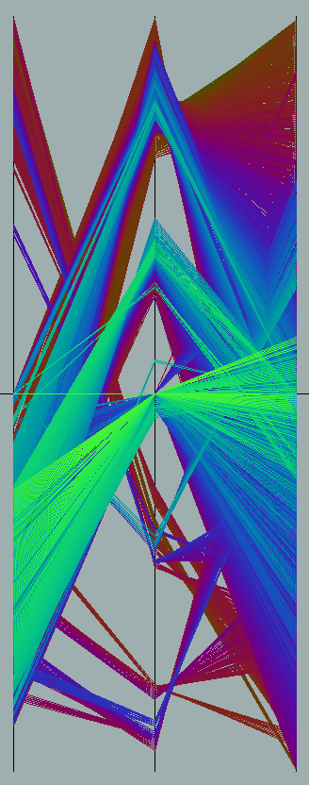
Parallel Coordinates of a Data Set

Slide 72
Icon-Based Visualization Techniques
Visualization of the data values as features of icons
Typical visualization methods
Chernoff Faces
Stick Figures
General techniques
Shape coding: Use shape to represent certain information encoding
Color icons: Use color icons to encode more information
Tile bars: Use small icons to represent the relevant feature vectors in document retrieval

Slide 73
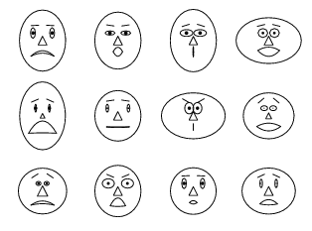
Chernoff Faces
A way to display variables on a two-dimensional surface, e.g., let x be eyebrow slant, y be eye size, z be nose length, etc.
The figure shows faces produced using 10 characteristics--head eccentricity, eye size, eye spacing, eye eccentricity, pupil size, eyebrow slant, nose size, mouth shape, mouth size, and mouth opening): Each assigned one of 10 possible values, generated using Mathematica (S. Dickson)
REFERENCE: Gonick, L. and Smith, W. The Cartoon Guide to Statistics. New York: Harper Perennial, p. 212, 1993
Weisstein, Eric W. "Chernoff Face." From MathWorld--A Wolfram Web Resource. mathworld.wolfram.com/ChernoffFace.html

Slide 74
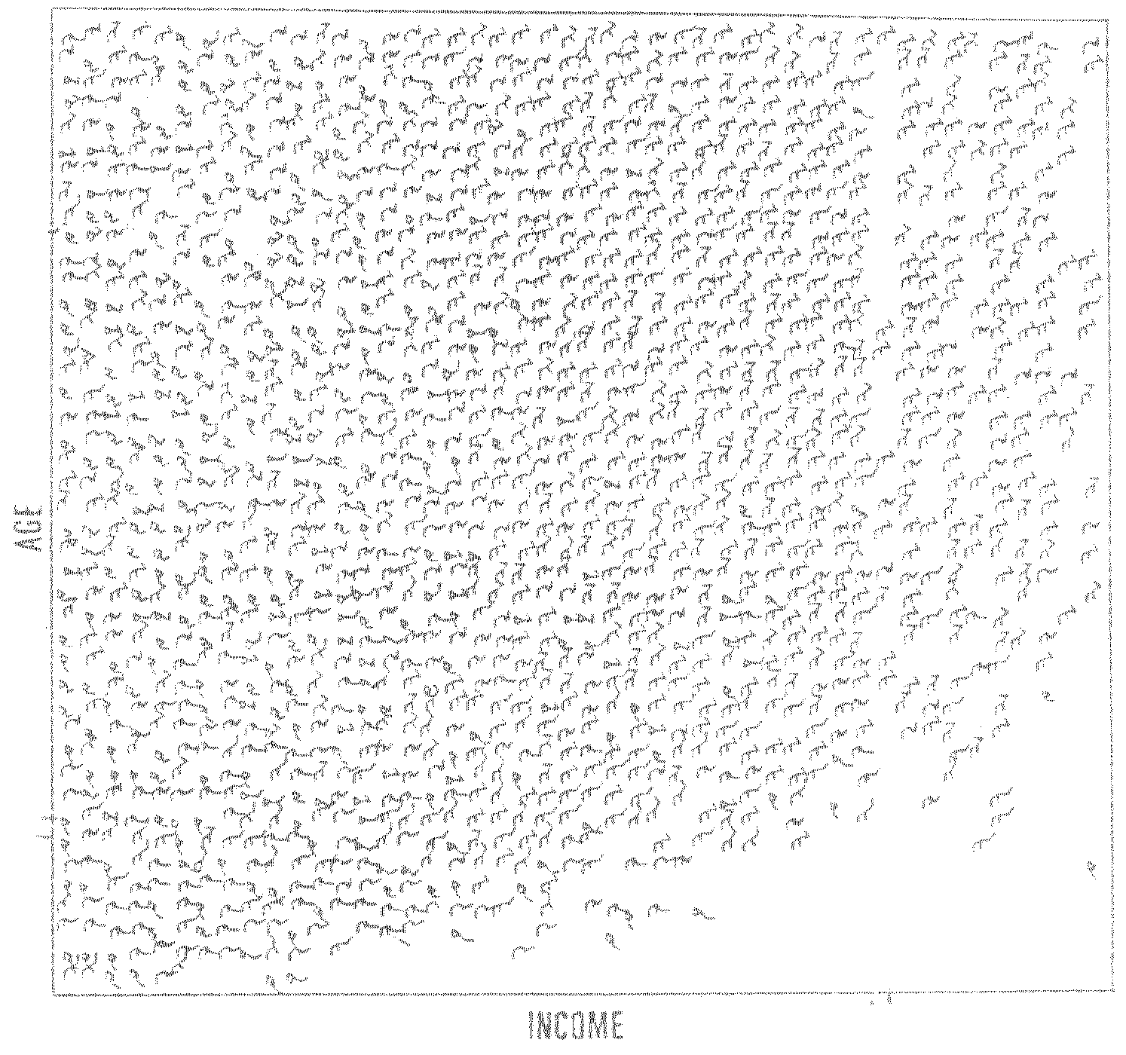
Stick Figure
A census data figure showing age, income, gender, education, etc.
used by permission of G. Grinstein, University of Massachusettes at Lowell
A 5-piece stick figure (1 body and 4 limbs w. different angle/length)
Two attributes mapped to axes, remaining attributes mapped to angle or length of limbs”. Look at texture pattern

Slide 75
Hierarchical Visualization Techniques
Visualization of the data using a hierarchical partitioning into subspaces
Methods
Dimensional Stacking
Worlds-within-Worlds
Tree-Map
Cone Trees
InfoCube

Slide 76
Dimensional Stacking
Partitioning of the n-dimensional attribute space in 2-D subspaces, which are ‘stacked’ into each other
Partitioning of the attribute value ranges into classes. The important attributes should be used on the outer levels.
Adequate for data with ordinal attributes of low cardinality
But, difficult to display more than nine dimensions
Important to map dimensions appropriately

Slide 77
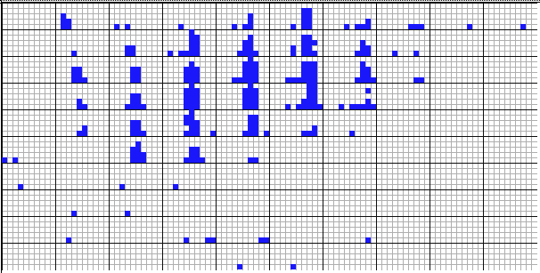
Dimensional Stacking
Used by permission of M. Ward, Worcester Polytechnic Institute
Visualization of oil mining data with longitude and latitude mapped to the outer x-, y-axes and ore grade and depth mapped to the inner x-, y-axes

Slide 78
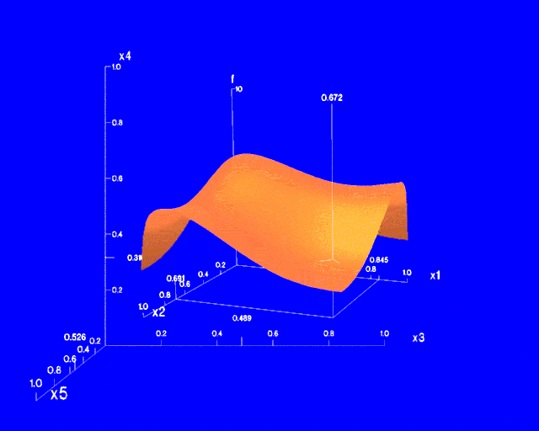
Worlds-within-Worlds
Assign the function and two most important parameters to innermost world
Fix all other parameters at constant values - draw other (1 or 2 or 3 dimensional worlds choosing these as the axes)
Software that uses this paradigm
N–vision: Dynamic interaction through data glove and stereo displays, including rotation, scaling (inner) and translation (inner/outer)
Auto Visual: Static interaction by means of queries

Slide 79
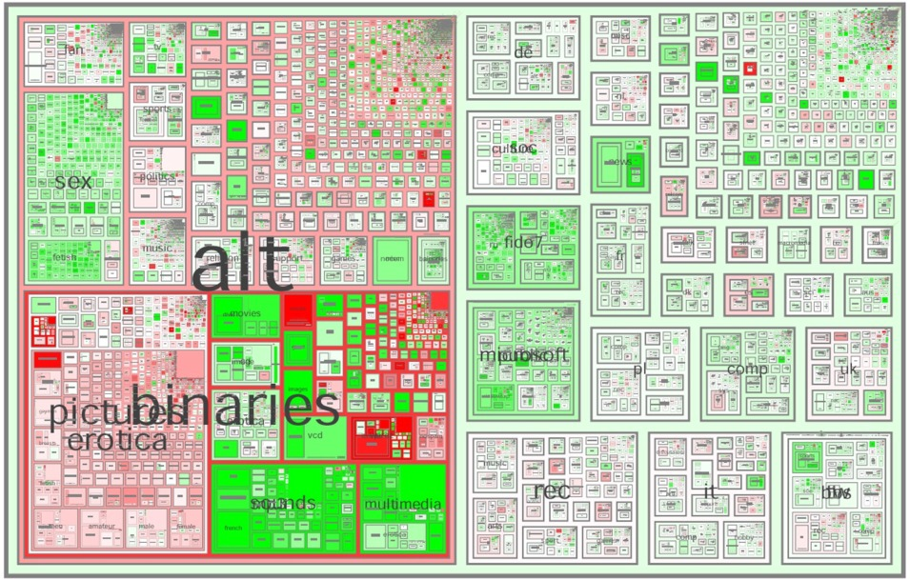
Tree-Map
Screen-filling method which uses a hierarchical partitioning of the screen into regions depending on the attribute values
The x- and y-dimension of the screen are partitioned alternately according to the attribute values (classes)
MSR Netscan Image
Ack.: http://www.cs.umd.edu/hcil/treemap-history/all102001.jpg

Slide 80
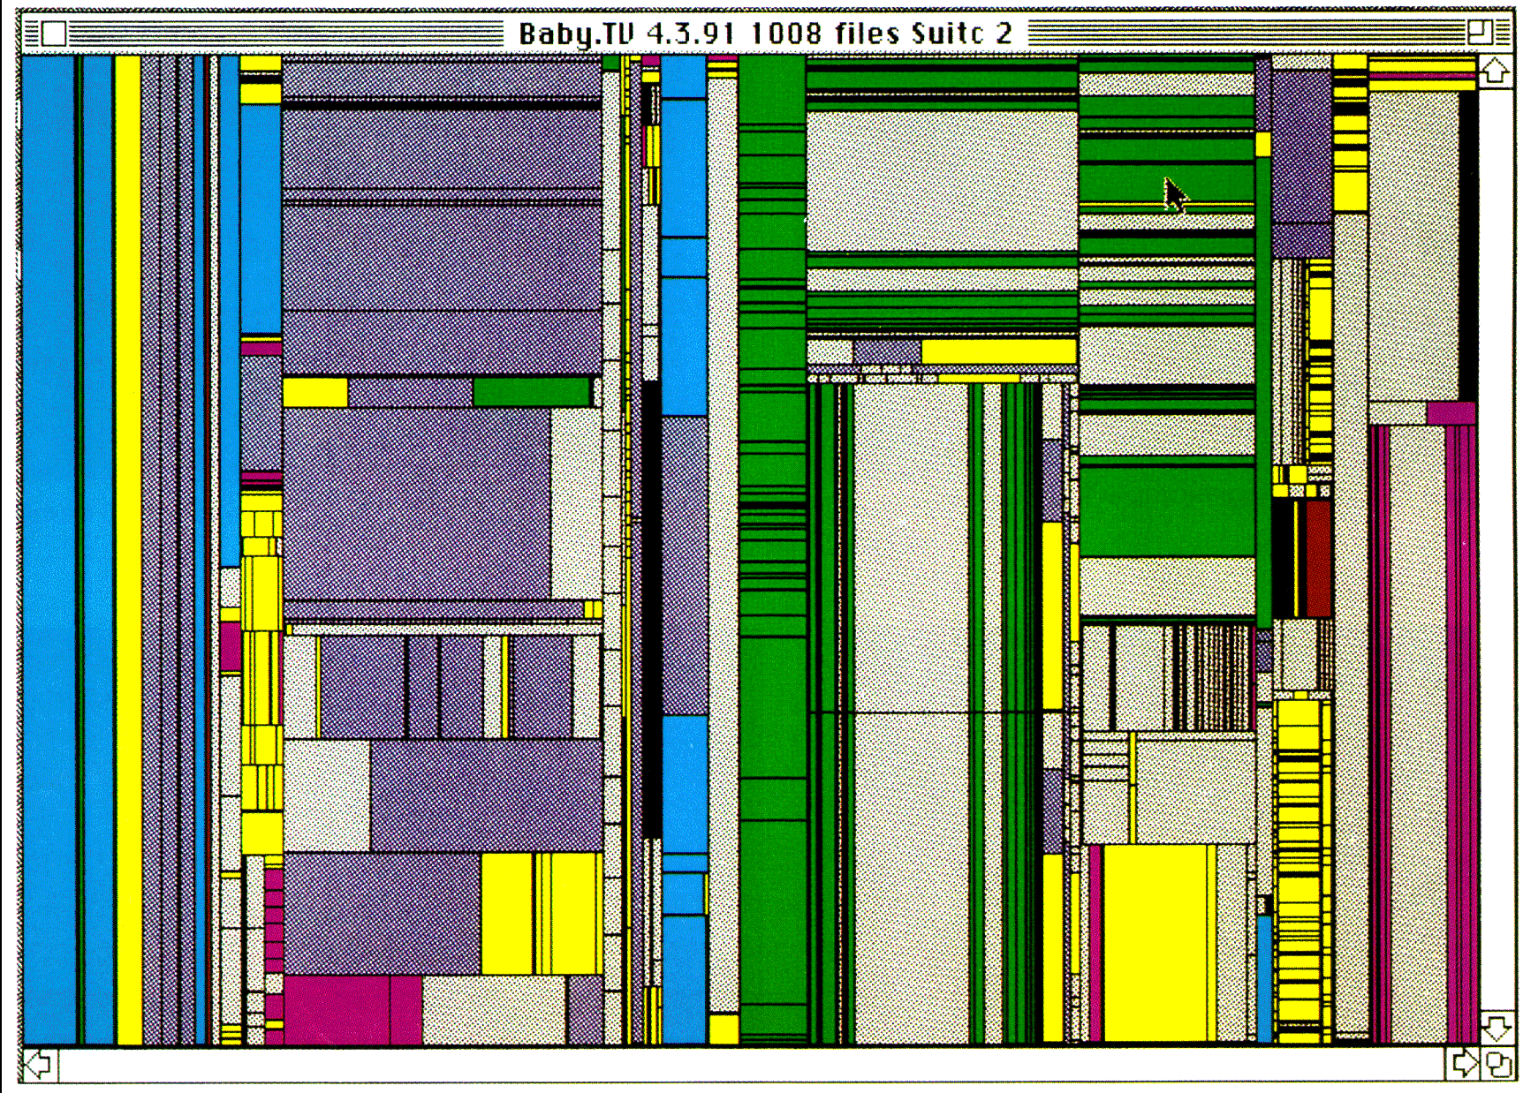
Tree-Map of a File System (Schneiderman)

Slide 81

InfoCube
A 3-D visualization technique where hierarchical information is displayed as nested semi-transparent cubes
The outermost cubes correspond to the top level data, while the subnodes or the lower level data are represented as smaller cubes inside the outermost cubes, and so on

Slide 82
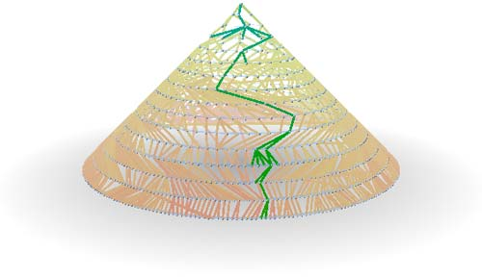
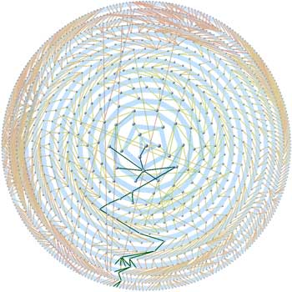
Three-D Cone Trees
3D cone tree visualization technique works well for up to a thousand nodes or so
First build a 2D circle tree that arranges its nodes in concentric circles centered on the root node
Cannot avoid overlaps when projected to 2D
G. Robertson, J. Mackinlay, S. Card. “Cone Trees: Animated 3D Visualizations of Hierarchical Information”, ACM SIGCHI'91
Graph from Nadeau Software Consulting website: Visualize a social network data set that models the way an infection spreads from one person to the next
Ack.: http://nadeausoftware.com/articles/visualization

Slide 83
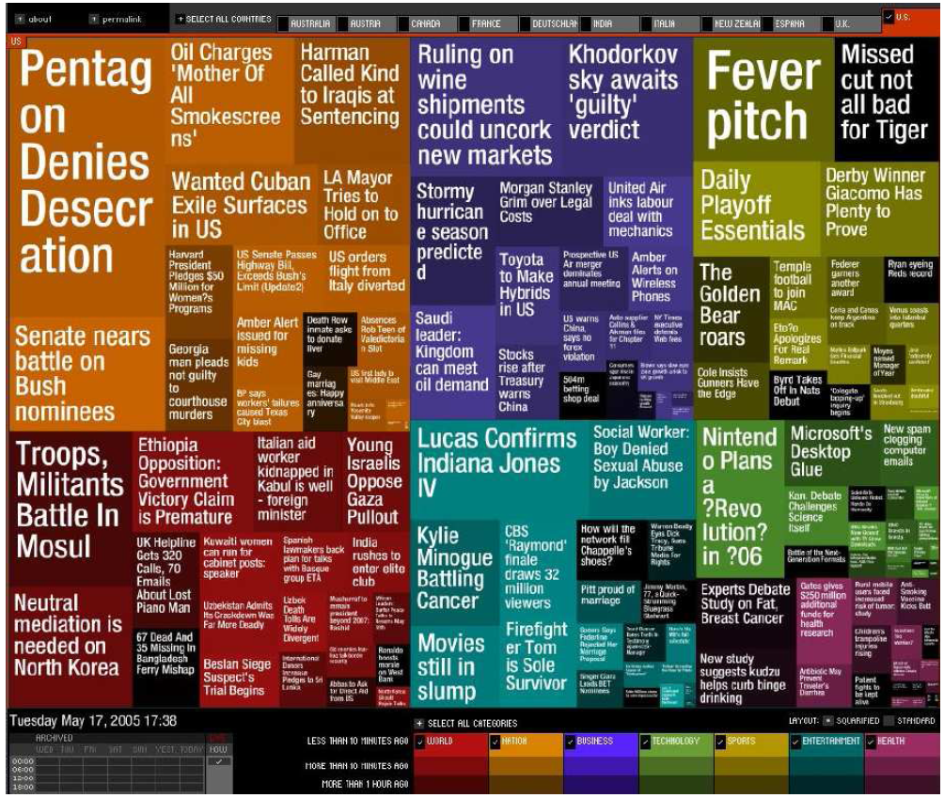
Visualizing Complex Data and Relations
Visualizing non-numerical data: text and social networks
Tag cloud: visualizing user-generated tags
The importance of tag is represented by font size/color
Besides text data, there are also methods to visualize relationships, such as visualizing social networks
Newsmap: Google News Stories in 2005

Slide 85
Similarity and Dissimilarity
Similarity
Numerical measure of how alike two data objects are
Value is higher when objects are more alike
Often falls in the range [0,1]
Dissimilarity (e.g., distance)
Numerical measure of how different two data objects are
Lower when objects are more alike
Minimum dissimilarity is often 0
Upper limit varies
Proximity refers to a similarity or dissimilarity

Slide 86
Data Matrix and Dissimilarity Matrix
Data matrix
n data points with p dimensions
Two modes
Dissimilarity matrix
n data points, but registers only the distance
A triangular matrix
Single mode

Slide 87
Proximity Measure for Nominal Attributes
Can take 2 or more states, e.g., red, yellow, blue, green (generalization of a binary attribute)
Method 1: Simple matching
m: # of matches, p: total # of variables
Method 2: Use a large number of binary attributes
creating a new binary attribute for each of the M nominal states

Slide 88
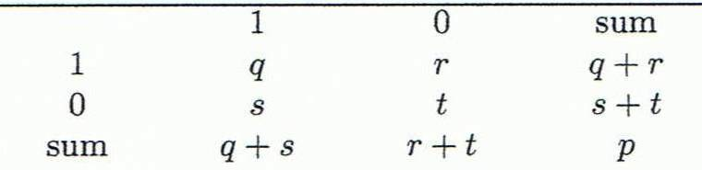
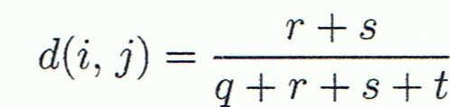
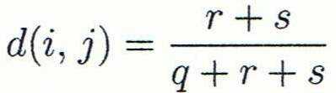

Proximity Measure for Binary Attributes
Object j
A contingency table for binary data
Distance measure for symmetric binary variables:
Distance measure for asymmetric binary variables:
Jaccard coefficient (similarity measure for asymmetric binary variables):
Object i
Note: Jaccard coefficient is the same as “coherence”:

Slide 89
Dissimilarity between Binary Variables
Example
Gender is a symmetric attribute
The remaining attributes are asymmetric binary
Let the values Y and P be 1, and the value N 0

Slide 90
Standardizing Numeric Data
Z-score:
X: raw score to be standardized, μ: mean of the population, σ: standard deviation
the distance between the raw score and the population mean in units of the standard deviation
negative when the raw score is below the mean, “+” when above
An alternative way: Calculate the mean absolute deviation
where
standardized measure (z-score):
Using mean absolute deviation is more robust than using standard deviation

Slide 91
Example: Data Matrix and Dissimilarity Matrix
Data Matrix
Dissimilarity Matrix
(with Euclidean Distance)

Slide 92
Distance on Numeric Data: Minkowski Distance
Minkowski distance: A popular distance measure
where i = (x_{i1}, x_{i2}, …, x_{ip}) and j = (x_{j1}, x_{j2}, …, x_{jp}) are two p-dimensional data objects, and h is the order (the distance so defined is also called L-h norm)
Properties
d(i, j) > 0 if i ≠ j, and d(i, i) = 0 (Positive definiteness)
d(i, j) = d(j, i) (Symmetry)
d(i, j) ≤ d(i, k) + d(k, j) (Triangle Inequality)
A distance that satisfies these properties is a metric

Slide 93
Special Cases of Minkowski Distance
h = 1: Manhattan (city block, L₁ norm) distance
E.g., the Hamming distance: the number of bits that are different between two binary vectors
h = 2: (L₂ norm) Euclidean distance
h → ∞. “supremum” (L_{max} norm, L∞ norm) distance.
This is the maximum difference between any component (attribute) of the vectors

Slide 94
Example: Minkowski Distance
Dissimilarity Matrices
Manhattan (L₁)
Euclidean (L₂)
Supremum

Slide 95
Ordinal Variables
An ordinal variable can be discrete or continuous
Order is important, e.g., rank
Can be treated like interval-scaled
replace x_{if} by their rank
map the range of each variable onto [0, 1] by replacing i-th object in the f-th variable by
compute the dissimilarity using methods for interval-scaled variables

Slide 96
Attributes of Mixed Type
A database may contain all attribute types
Nominal, symmetric binary, asymmetric binary, numeric, ordinal
One may use a weighted formula to combine their effects
f is binary or nominal:
d_{ij}^{(f)} = 0 if x_{if} = x_{jf} , or d_{ij}^{(f)} = 1 otherwise
f is numeric: use the normalized distance
f is ordinal
Compute ranks r_{if} and
Treat z_{if} as interval-scaled

Slide 97
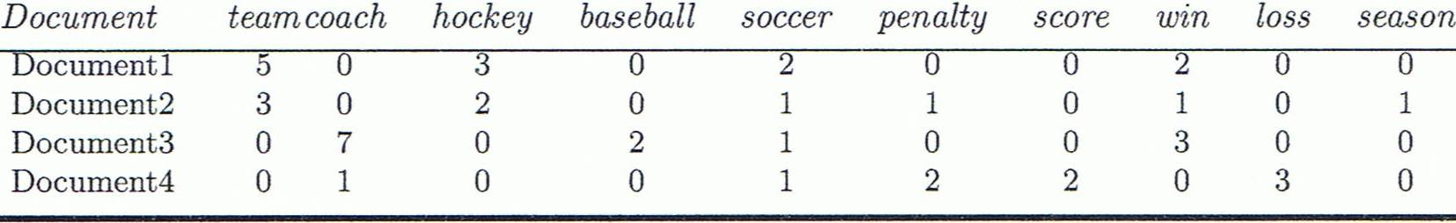
Cosine Similarity
A document can be represented by thousands of attributes, each recording the frequency of a particular word (such as keywords) or phrase in the document.
Other vector objects: gene features in micro-arrays, …
Applications: information retrieval, biologic taxonomy, gene feature mapping, ...
Cosine measure: If d₁ and d₂ are two vectors (e.g., term-frequency vectors), then
cos(d₁, d₂) = (d₁ • d₂) /||d₁|| ||d₂|| ,
where • indicates vector dot product, ||d||: the length of vector d

Slide 98
Example: Cosine Similarity
cos(d₁, d₂) = (d₁ • d₂) /||d₁|| ||d₂|| ,
where • indicates vector dot product, ||d|: the length of vector d
Ex: Find the similarity between documents 1 and 2.
d₁ = (5, 0, 3, 0, 2, 0, 0, 2, 0, 0)
d₂ = (3, 0, 2, 0, 1, 1, 0, 1, 0, 1)
d₁•d₂ = 5*3+0*0+3*2+0*0+2*1+0*1+0*1+2*1+0*0+0*1 = 25
||d₁||= (5*5+0*0+3*3+0*0+2*2+0*0+0*0+2*2+0*0+0*0)^{0.5}=(42)^{0.5} = 6.481
||d₂||= (3*3+0*0+2*2+0*0+1*1+1*1+0*0+1*1+0*0+1*1)^{0.5}=(17)^{0.5} = 4.12
cos(d₁, d₂ ) = 0.94

Slide 99
THANK YOU

